Slide 1


Care
And
Feeding
Of The
Data
Monster

Slide 2


Slide 3
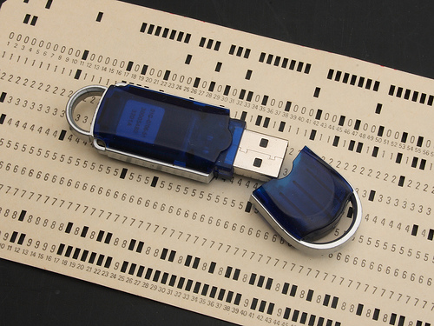
Notes:
Computing Resources have come a long ways.
GUI’s change, but underlying data is universal

Slide 4
What are data skills?

Slide 5
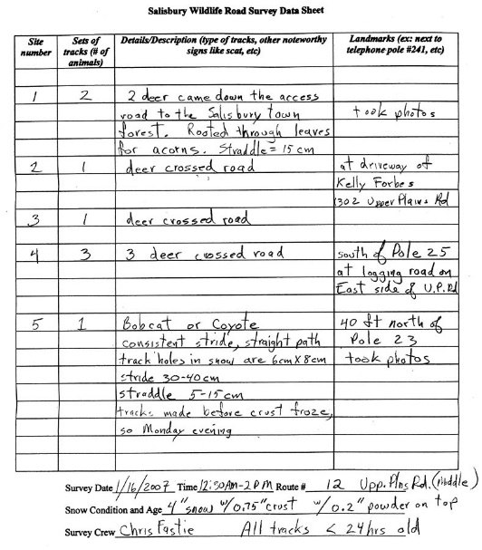

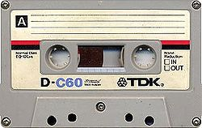
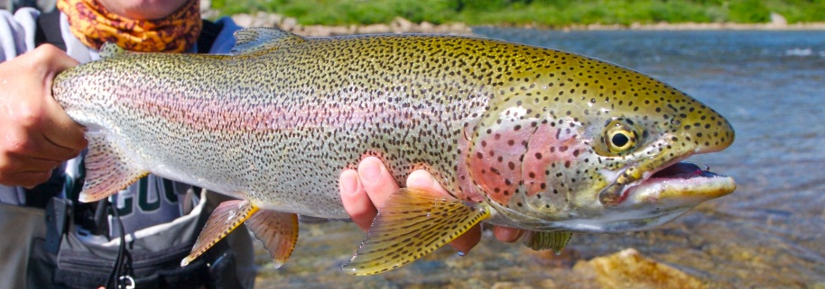
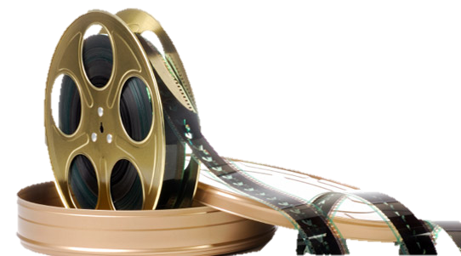
What is data?

Slide 6
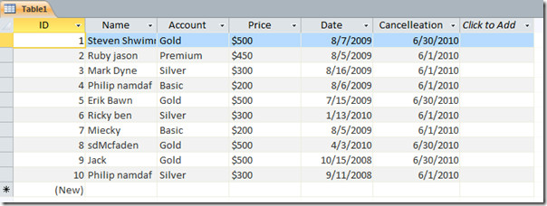
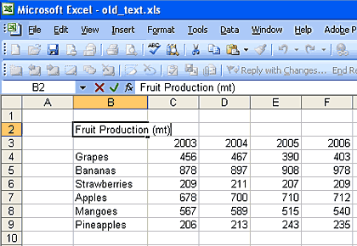

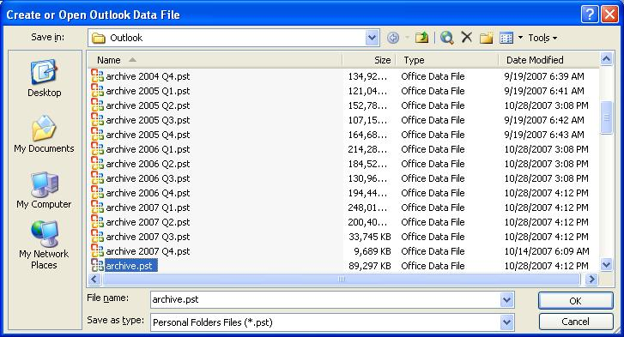
What is a datastore?

Slide 7
What is a database?

Slide 8
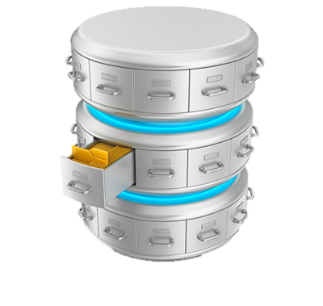
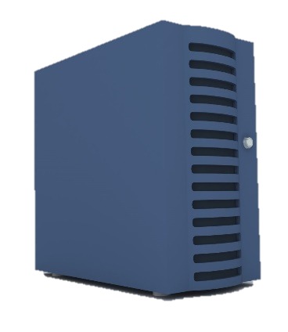
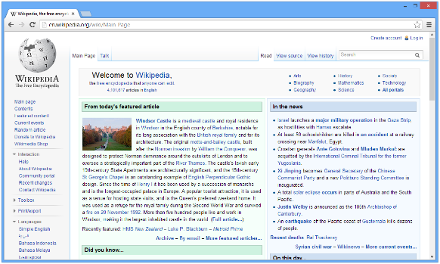

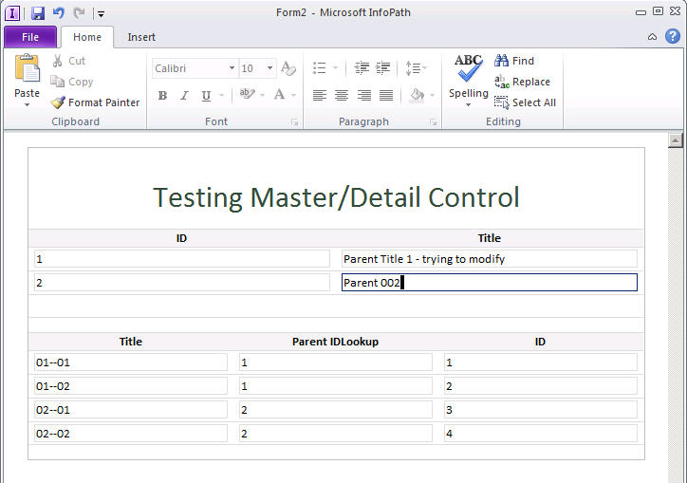



What is a data system?

Slide 9
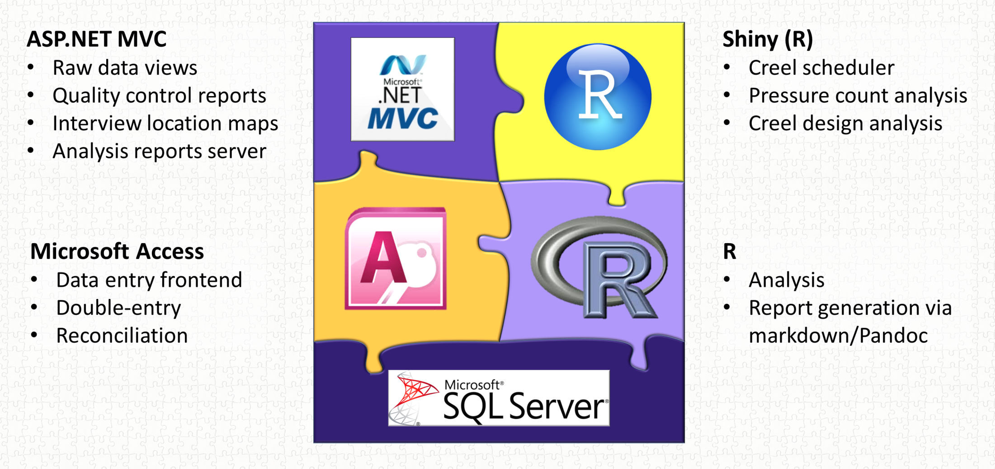
What is a data system?

Slide 10



Slide 11

Welcome
To The World
Of The Geek
Data
Management
Notes:
Actually…normally more reminiscent of engineers than geeks. There’s always some truth to all stereotypes, so what about the geek represents good qualities of data managers?
Retentive nature, same way-every time, accept menial repetitive tasks as the cost of business…..
This gives us a nice framework for thinking about data management.

Slide 12
Why is data management important to me?
Save Time!
Save Money!
No data…….no money
No data……no thesis
No data……no publications
Set yourself apart

Slide 13
Why is data management important to me?
Save Time!
Save Money!
No data…….no money
No data……no thesis
No data……no publications
Set yourself apart

Slide 14
Why is data management important to me?
Save Time!
Save Money!
No data…….no money
No data……no thesis
No data……no publications
Set yourself apart

Slide 15

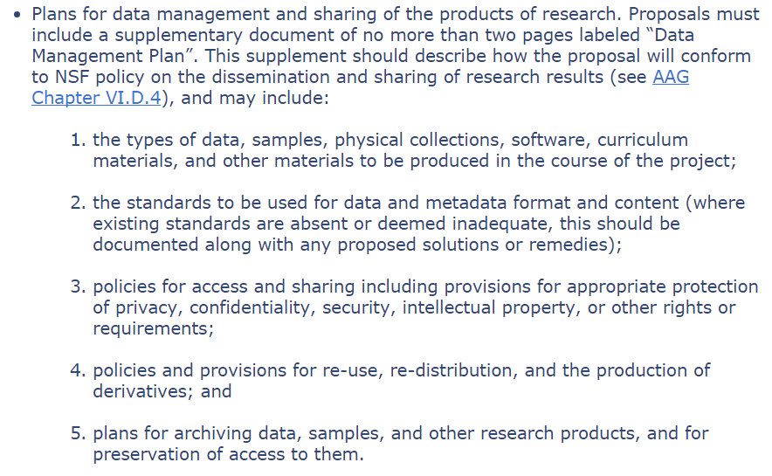

Slide 16
Why is data management important to me?
Save Time!
Save Money!
No data…….no money
No data……no thesis
No data……no publications
Set yourself apart

Slide 17
Why is data management important to me?
Save Time!
Save Money!
No data…….no money
No data……no thesis
No data……no publications
Set yourself apart

Slide 18
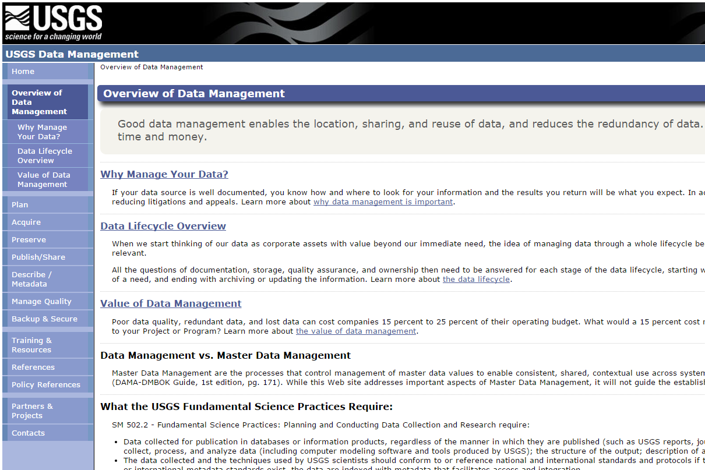

Slide 19
Data Management
"Data Resource Management is the development and execution of architectures, policies, practices and procedures that properly manage the full data lifecycle needs of an enterprise.“
– DAMA International

Slide 20
Data Management
“Use of policies and procedures to protect and efficiently use information.“
– Keith Hurley

Slide 21
Data Management
“Use of policies and procedures to protect and efficiently use information.“
– Keith Hurley

Slide 22


Slide 23

Consistency
Detail
Redundancy
Notes:
Actually…normally more reminiscent of engineers than geeks. There’s always some truth to all stereotypes, so what about the geek represents good qualities of data managers?
Retentive nature, same way-every time, accept menial repetitive tasks as the cost of business…..
This gives us a nice framework for thinking about data management.

Slide 24
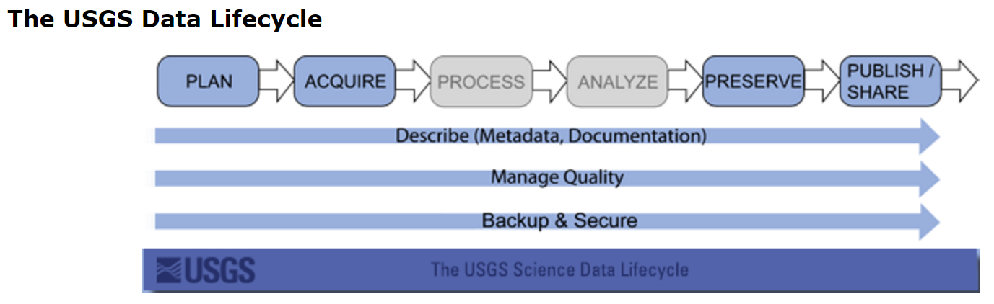

Slide 25

Data Lifecycle
Field/Lab
Data Entry
Active/Analysis
Archive

Slide 26
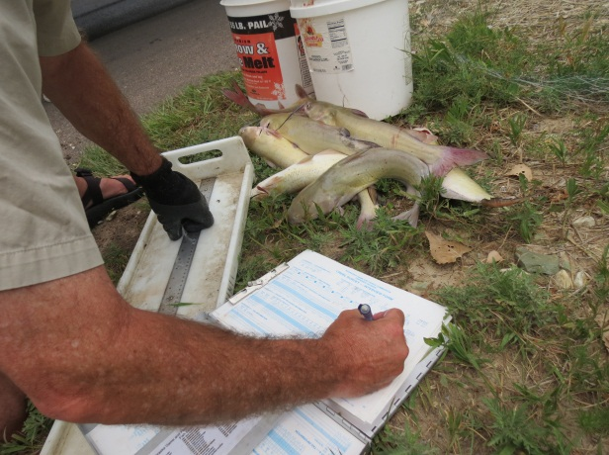
Field/Lab
Notes:
Layout
Units
Conversions/Codes
Waterproof
Self-explanitory
Visual Cues For Necessary Information
Methods to detect missing samples

Slide 27
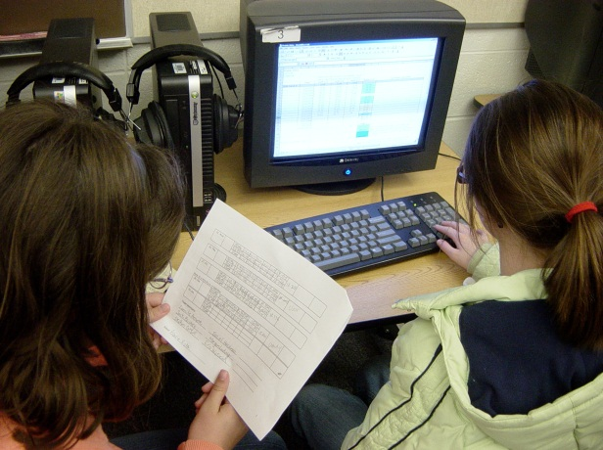
Data Entry
Notes:
Detect entry errors
Validation
Backup
Speed

Slide 28
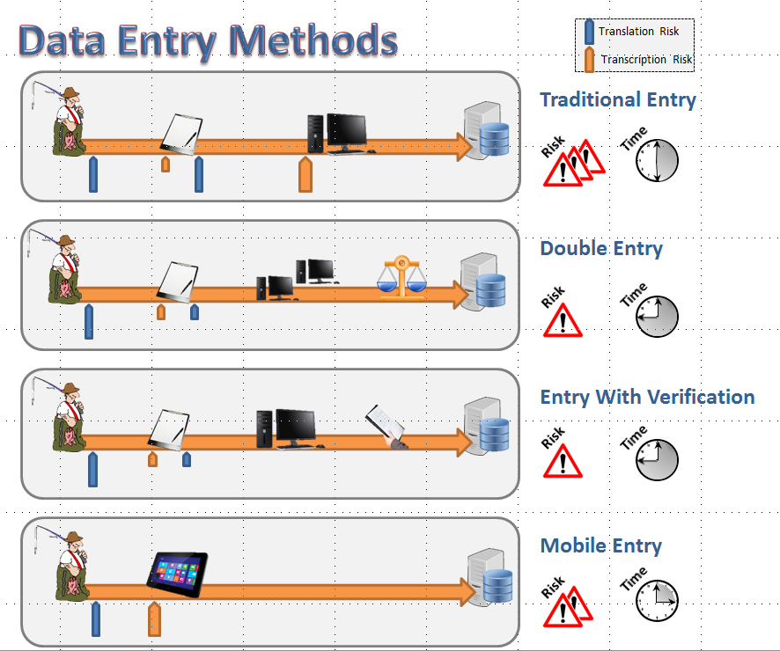
Notes:
Detect entry errors
Validation
Backup
Speed

Slide 29
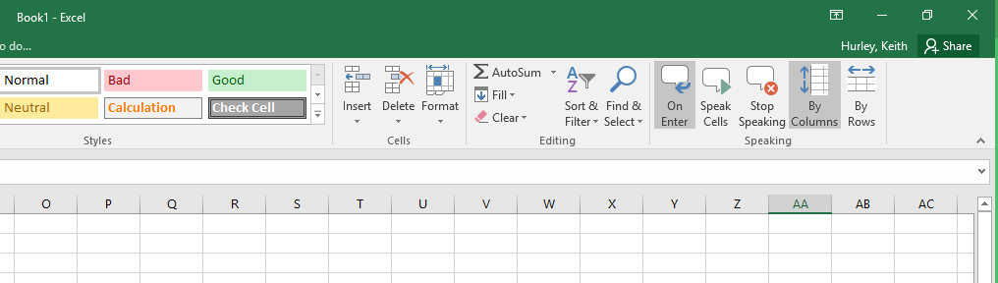

Slide 30
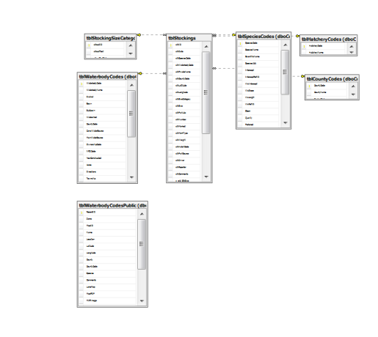
Active / Analysis

Slide 31

Archive
Notes:
Detect entry errors
Validation
Backup
Speed

Slide 32
Data Management
Field
Lab
Active/Analysis
Archive

Slide 33
Important Questions
Who can modify data?
Who can delete data?
Who can view data?
Who can use data?

Slide 34
When data is available,
people WILL seek to use it!

Slide 35
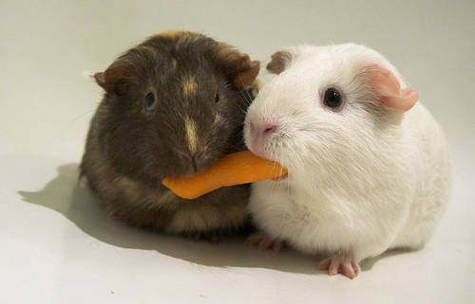
Notes:
Data Sharing
Technical How To
Ethical/Legal
Can I and Should I
Data sharing agreements
Freedom of information acts
Intellectual property rights

Slide 36
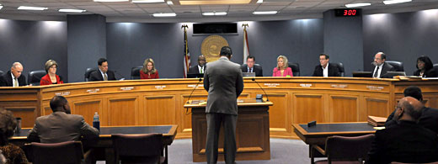

Slide 37






Databases
Notes:
Store and Retrieve Data
In our case tabular data

Slide 38




Notes:
Store and Retrieve Data
In our case tabular data

Slide 39




Slide 40

Flat Files

Slide 41

Flat Files
Spreadsheets

Slide 42
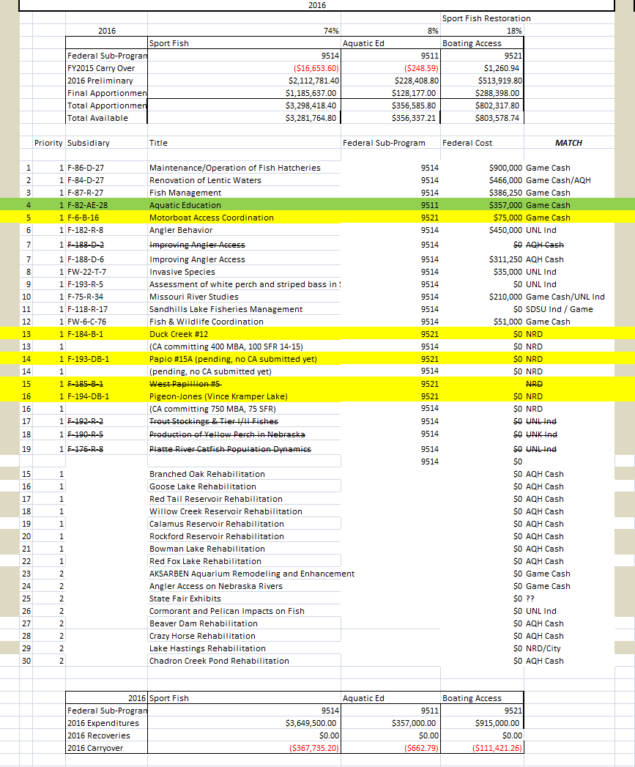
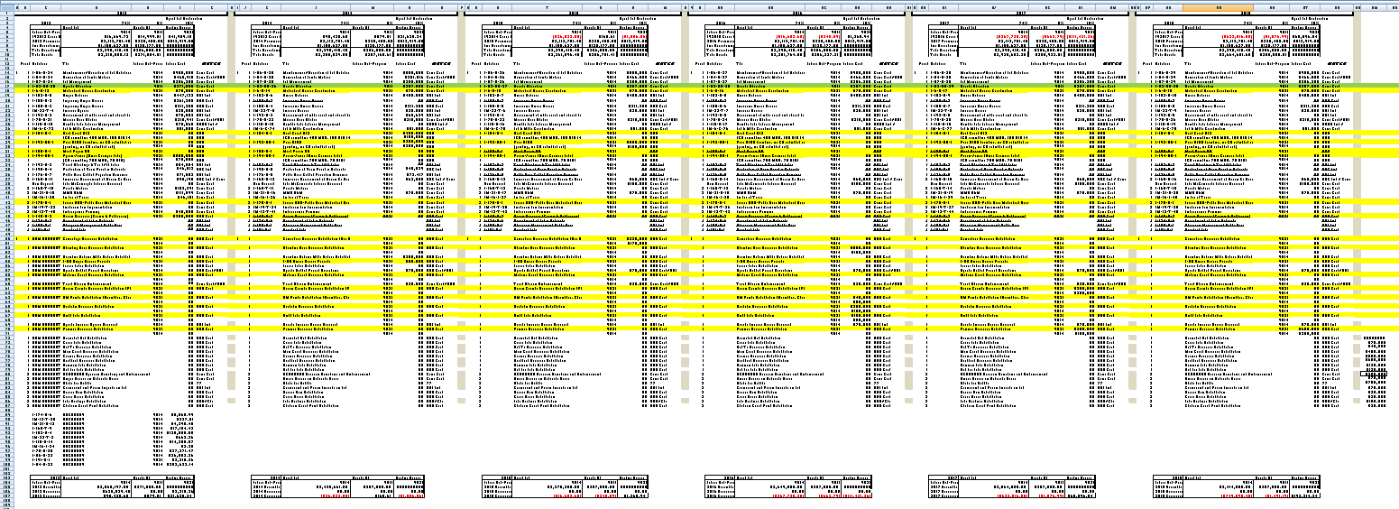

Slide 44



Slide 45
Do Not Use Spreadsheets

Slide 46

Flat Files
Spreadsheets
Statistical

Slide 47
Flat Files
Spreadsheets
Statistical
Non-Relational Databases

Slide 48



Flat Files
Spreadsheets
Statistical
Relational DB
Non-Relational Databases

Slide 49
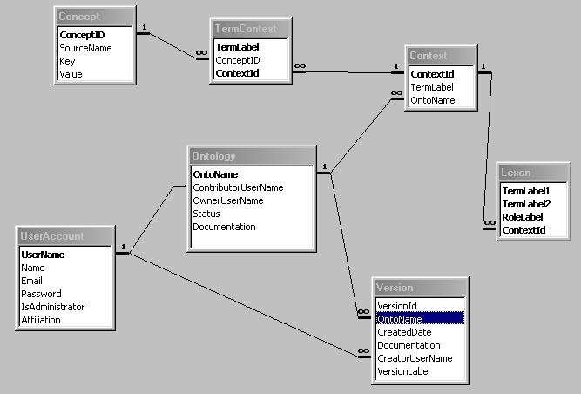
What is a relational database?
Notes:
Cascading updates and deletes to handle orphans and changes
Single point to change repeating values
Data has a “model” that relates to what it represents
Most are built around SQL language

Slide 50

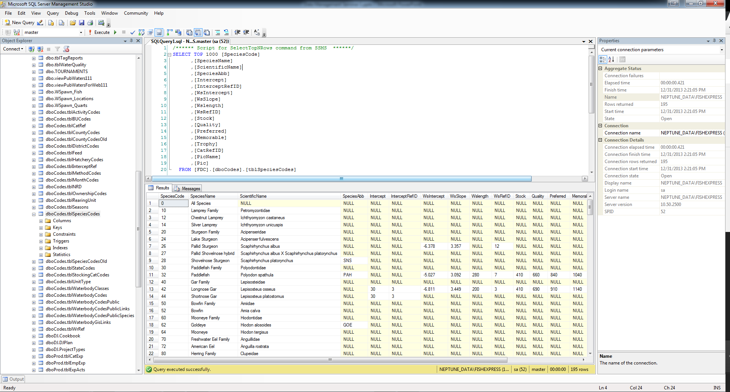
Stores Data
Runs Queries (Batch Operations)
Retrieves Data
Notes:
Can be on server or local computer
Mainly syntax (query) based
Views/Sprocs/Triggers
No real data entry capabilities
Only functional analysis capabilities

Slide 51
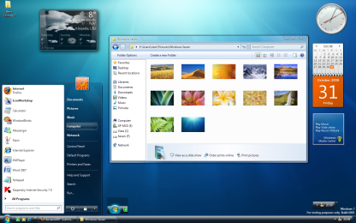
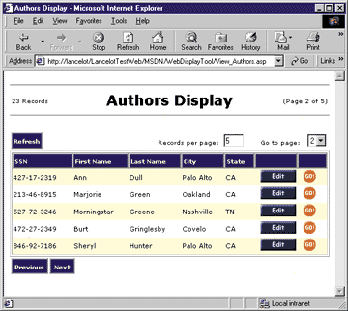
Stores Data
Runs Queries (Batch Operations)
Retrieves Data
Enter Data
Edit Data
Reports
Analysis
Enter Data
Edit Data
Reports
Analysis
Reports
Analysis

Slide 52

Enter Data
Edit Data
Reports
Analysis
Stores Data
Runs Queries (Batch Operations)
Retrieves Data
Reports
Analysis

Slide 53
Tables
Queries
Forms
Forms
Forms
Forms
Notes:
What do you lose with access………views, stored procedures, triggers, multi-user issues

Slide 54
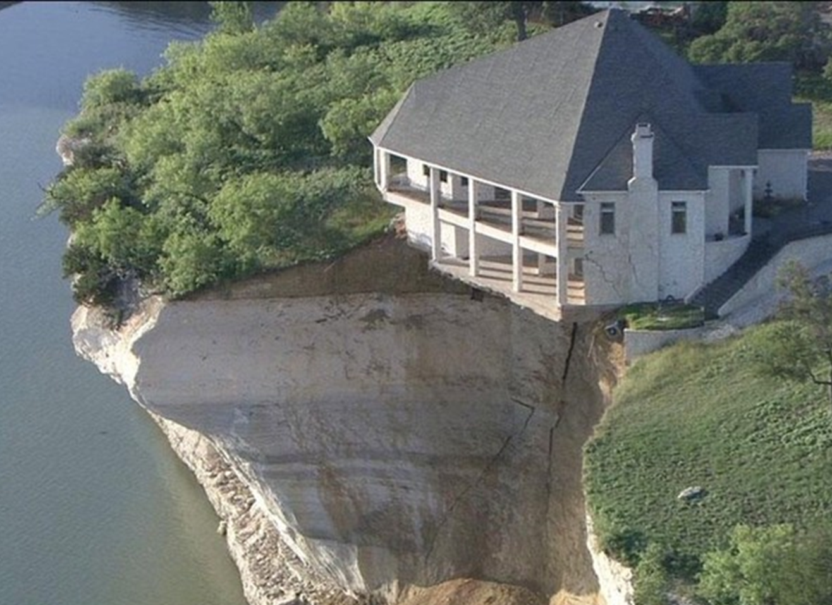
Designing
A
Database
Notes:
Use access to show how to design a database
Good design means
simpler queries
better performance
less data entry
easier to add data fields without breaking backwards compatibility
Think of records as an “entity”…and then “sets” of entities”

Slide 55
I’ve Learned So Much From My Mistakes…
I’m Thinking Of Making A Few More
Notes:
We’ve all made mistakes
Share one of mine.

Slide 56
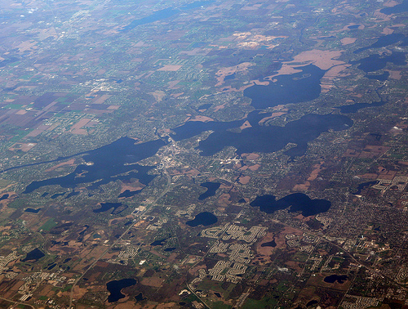
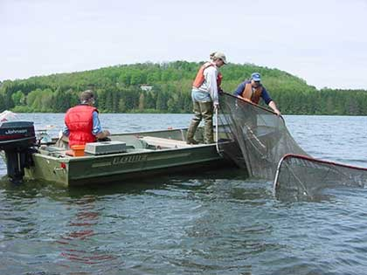
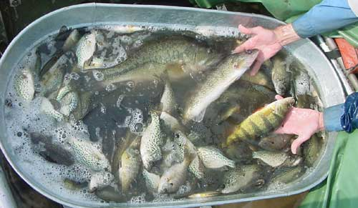
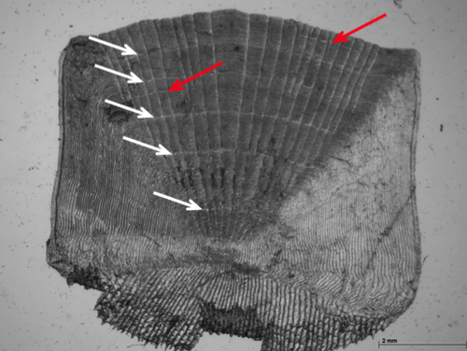
Notes:
Cascading updates and deletes to handle orphans and changes
Single point to change repeating values
Data has a “model” that relates to what it represents
Most are built around SQL language

Slide 57
date | lake | site | gear | species | length | weight | age | a1 | a2 | a3 | a4 | edge
06/01/13 | Round | Loon Point | Trap Net | bluegill | 210 | 254 | 4 | 178 | 223 | 381 | 413 | 413
06/01/13 | Round | Loon Point | Trap Net | bluegill | 243 | 222 | 4 | 145 | 242 | 335 | 481 | 490
06/01/13 | Round | Pintail Bay | Trap Net | bluegill | 135 | 86 | 2 | 195 | 284 |  |  | 292
06/01/13 | Round | West end of dam | Trap Net | redear | 142
06/25/13 | Round | Loon Point | Trap Net | black bullhead | 138
06/25/13 | Round | Pintail Bay | Trap Net | black bullhead | 179
06/25/13 | Round | Big Creek mouth | Trap Net | bluegill | 198 | 168 | 3 | 188 | 254 | 365 |  | 365
08/30/13 | Square | Mallard Cove | Gill Net | walleye | 854 | 355 | 4 | 113 | 241 | 384 | 476 | 484
08/30/13 | Square | Whitetail Point | Gill Net | walleye | 686 | 321 | 3 | 105 | 289 | 349 |  | 349
08/30/13 | Square | Bobber Bay | Gill Net | white bass | 312 | 211 |  |  |  |  |  | 230

Slide 58
date | lake | site | gear | species | length | weight | age | a1 | a2 | a3 | a4 | edge
06/01/13 | Round | Loon Point | 1 | 1 | 210 | 254 | 4 | 178 | 223 | 381 | 413 | 413
06/01/13 | Round | Loon Point | 1 | 1 | 243 | 222 | 4 | 145 | 242 | 335 | 481 | 490
06/01/13 | Round | Pintail Bay | 1 | 1 | 135 | 86 | 2 | 195 | 284 |  |  | 292
06/01/13 | Round | West end of dam | 1 | 2 | 142
06/25/13 | Round | Loon Point | 1 | 3 | 138
06/25/13 | Round | Pintail Bay | 1 | 3 | 179
06/25/13 | Round | Big Creek mouth | 1 | 1 | 198 | 168 | 3 | 188 | 254 | 365 |  | 365
08/30/13 | Square | Mallard Cove | 2 | 4 | 854 | 355 | 4 | 113 | 241 | 384 | 476 | 484
08/30/13 | Square | Whitetail Point | 2 | 4 | 686 | 321 | 3 | 105 | 289 | 349 |  | 349
08/30/13 | Square | Bobber Bay | 2 | 5 | 312 | 211 |  |  |  |  |  | 230
tblSpecies
spp_UID | spp_Name
1 | bluegill
2 | redear
3 | black bullhead
4 | walleye
5 | white bass
tblGears
gear_UID | gear_Name
1 | Trap Net
2 | Gill Net

Slide 59
date | site | gear | species | length | weight | age | a1 | a2 | a3 | a4 | edge
06/01/13 | 1 | 1 | 1 | 210 | 254 | 4 | 178 | 223 | 381 | 413 | 413
06/01/13 | 1 | 1 | 1 | 243 | 222 | 4 | 145 | 242 | 335 | 481 | 490
06/01/13 | 2 | 1 | 1 | 135 | 86 | 2 | 195 | 284 |  |  | 292
06/01/13 | 3 | 1 | 2 | 142
06/25/13 | 1 | 1 | 3 | 138
06/25/13 | 2 | 1 | 3 | 179
06/25/13 | 4 | 1 | 1 | 198 | 168 | 3 | 188 | 254 | 365 |  | 365
08/30/13 | 5 | 2 | 4 | 854 | 355 | 4 | 113 | 241 | 384 | 476 | 484
08/30/13 | 6 | 2 | 4 | 686 | 321 | 3 | 105 | 289 | 349 |  | 349
08/30/13 | 7 | 2 | 5 | 312 | 211 |  |  |  |  |  | 230
tblSites
site_UID | Site_lakeUID | site_Name
1 | 1 | Loon Point
2 | 1 | Pintail Bay
3 | 1 | West end of dam
4 | 1 | Big Creek mouth
5 | 2 | Mallard Cove
6 | 2 | Whitetail Point
7 | 2 | Bobber Bay
tblSpecies
spp_UID | spp_Name
1 | bluegill
2 | redear
3 | black bullhead
4 | walleye
5 | white bass
tblLakes
lake_UID | lake_Name
1 | Round
2 | Square
tblGears
gear_UID | gear_Name
1 | Trap Net
2 | Gill Net

Slide 60
date | site | gear | species | length | weight | age | a1 | a2 | a3 | a4 | edge
06/01/13 | 1 | 1 | 1 | 210 | 254 | 4 | 178 | 223 | 381 | 413 | 413
06/01/13 | 1 | 1 | 1 | 243 | 222 | 4 | 145 | 242 | 335 | 481 | 490
06/01/13 | 2 | 1 | 1 | 135 | 86 | 2 | 195 | 284 |  |  | 292
06/01/13 | 3 | 1 | 2 | 142
06/25/13 | 1 | 1 | 3 | 138
06/25/13 | 2 | 1 | 3 | 179
06/25/13 | 4 | 1 | 1 | 198 | 168 | 3 | 188 | 254 | 365 |  | 365
08/30/13 | 5 | 2 | 4 | 854 | 355 | 4 | 113 | 241 | 384 | 476 | 484
08/30/13 | 6 | 2 | 4 | 686 | 321 | 3 | 105 | 289 | 349 |  | 349
08/30/13 | 7 | 2 | 5 | 312 | 211 |  |  |  |  |  | 230

Slide 61
tblSets
set_UID | set_Date | set_Site | set_Gear
1 | 6/1/2013 | 1 | 1
2 | 6/1/2013 | 2 | 1
3 | 6/1/2013 | 3 | 1
4 | 6/25/2013 | 1 | 1
5 | 6/25/2013 | 2 | 1
6 | 6/25/2013 | 4 | 1
7 | 8/30/2013 | 5 | 2
8 | 8/30/2013 | 6 | 2
9 | 8/30/2013 | 7 | 2
tblFish
fish_UID | fish_setUID | fish_sppUID | fish_length | fish_weight | fish_age | a1 | a2 | a3 | a4 | edge
1 | 1 | 1 | 210 | 254 | 4 | 178 | 223 | 381 | 413 | 413
2 | 1 | 1 | 243 | 222 | 4 | 145 | 242 | 335 | 481 | 490
3 | 2 | 1 | 135 | 86 | 2 | 195 | 284 |  |  | 292
4 | 3 | 2 | 142
5 | 4 | 3 | 138
6 | 5 | 3 | 179
7 | 6 | 1 | 198 | 168 | 3 | 188 | 254 | 365 |  | 365
8 | 7 | 4 | 854 | 355 | 4 | 113 | 241 | 384 | 476 | 484
9 | 8 | 4 | 686 | 321 | 3 | 105 | 289 | 349 |  | 349
10 | 9 | 5 | 312 | 211 |  |  |  |  |  | 230

Slide 62
tblSets
set_UID | set_Date | set_Site | set_Gear
1 | 6/1/2013 | 1 | 1
2 | 6/1/2013 | 2 | 1
3 | 6/1/2013 | 3 | 1
4 | 6/25/2013 | 1 | 1
5 | 6/25/2013 | 2 | 1
6 | 6/25/2013 | 4 | 1
7 | 8/30/2013 | 5 | 2
8 | 8/30/2013 | 6 | 2
9 | 8/30/2013 | 7 | 2
tblFish
fish_UID | fish_setUID | fish_sppUID | fish_length | fish_weight | fish_age | fish_edge
1 | 1 | 1 | 210 | 254 | 4 | 413
2 | 1 | 1 | 243 | 222 | 4 | 490
3 | 2 | 1 | 135 | 86 | 2 | 292
4 | 3 | 2 | 142
5 | 4 | 3 | 138
6 | 5 | 3 | 179
7 | 6 | 1 | 198 | 168 | 3 | 365
8 | 7 | 4 | 854 | 355 | 4 | 484
9 | 8 | 4 | 686 | 321 | 3 | 349
10 | 9 | 5 | 312 | 211 |  | 230
tblAge
age_UID | age_fishUID | age_age | age_annulus
1 | 1 | 1 | 178
2 | 1 | 2 | 223
3 | 1 | 3 | 381
4 | 1 | 4 | 413
5 | 2 | 1 | 145
6 | 2 | 2 | 242
7 | 2 | 3 | 335
8 | 2 | 4 | 481
9 | 3 | 1 | 195
10 | 3 | 2 | 284
11 | 7 | 1 | 188
12 | 7 | 2 | 254
13 | 7 | 3 | 365
14 | 8 | 1 | 113
15 | 8 | 2 | 241
16 | 8 | 3 | 384
17 | 8 | 4 | 476
18 | 9 | 1 | 105
19 | 9 | 2 | 289
20 | 9 | 3 | 349

Slide 63
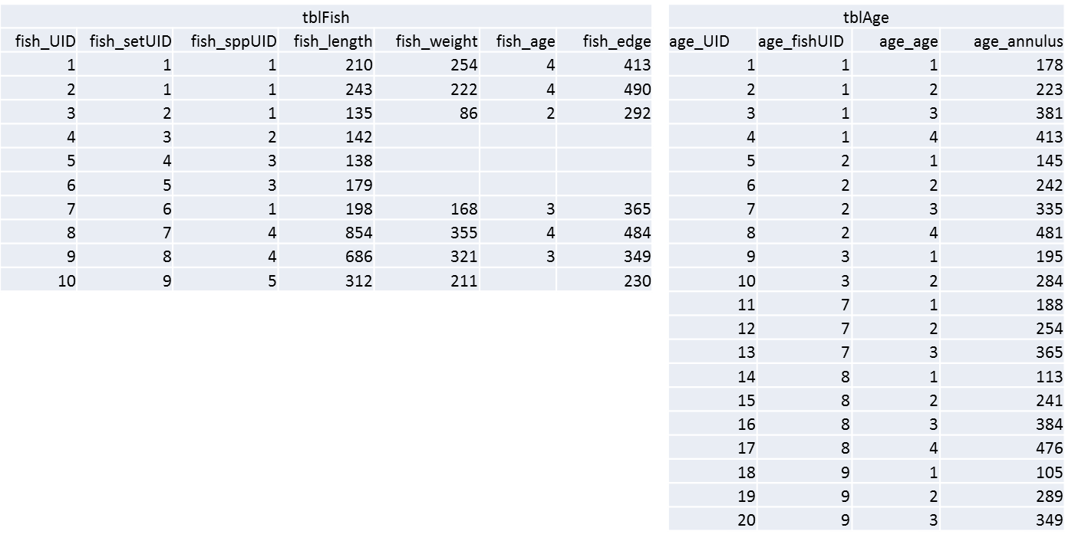
SELECT tblFish.fish_UID, tblAge.age_age, [Intercept]+([fish_length]-[Intercept])*([age_annulus]/[fish_edge]) AS LAA
FROM (tblSpecies INNER JOIN tblFish ON tblSpecies.spp_UID = tblFish.fish_sppUID) INNER JOIN tblAge ON tblFish.fish_UID = tblAge.age_fishUID;

Slide 64
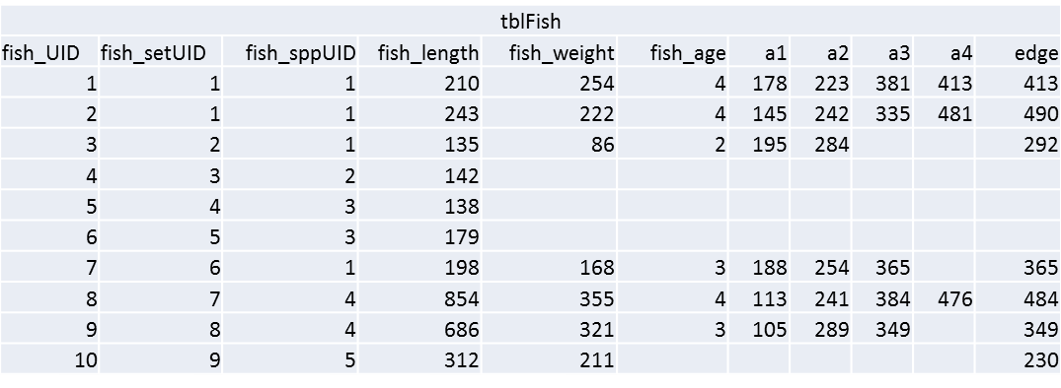
SELECT tblFish.fish_UID, tblAge.age_age, [Intercept]+([fish_length]-[Intercept])*([age_annulus]/[fish_edge]) AS LAA
FROM (tblSpecies INNER JOIN tblFish ON tblSpecies.spp_UID = tblFish.fish_sppUID) INNER JOIN tblAge ON tblFish.fish_UID = tblAge.age_fishUID;
SELECT tblFish.fish_UID, tblAge.age_age, [Intercept]+([fish_length]-[Intercept])*([age_annulus1]/[fish_edge]) AS LAA1, [Intercept]+([fish_length]-[Intercept])*([age_annulus2]/[fish_edge]) AS LAA2, [Intercept]+([fish_length]-[Intercept])*([age_annulus3]/[fish_edge]) AS LAA3, [Intercept]+([fish_length]-[Intercept])*([age_annulus4]/[fish_edge]) AS LAA4 FROM (tblSpecies INNER JOIN tblFish ON tblSpecies.spp_UID = tblFish.fish_sppUID) INNER JOIN tblAge ON tblFish.fish_UID = tblAge.age_fishUID;

Slide 65
SELECT tblFish.fish_UID, tblAge.age_age, [Intercept]+([fish_length]-[Intercept])*([age_annulus]/[fish_edge]) AS LAA
FROM (tblSpecies INNER JOIN tblFish ON tblSpecies.spp_UID = tblFish.fish_sppUID) INNER JOIN tblAge ON tblFish.fish_UID = tblAge.age_fishUID;
SELECT tblFish.fish_UID, tblAge.age_age, [Intercept]+([fish_length]-[Intercept])*([age_annulus1]/[fish_edge]) AS LAA1, [Intercept]+([fish_length]-[Intercept])*([age_annulus2]/[fish_edge]) AS LAA2, [Intercept]+([fish_length]-[Intercept])*([age_annulus3]/[fish_edge]) AS LAA3, [Intercept]+([fish_length]-[Intercept])*([age_annulus4]/[fish_edge]) AS LAA4, [Intercept]+([fish_length]-[Intercept])*([age_annulus5]/[fish_edge]) AS LAA5, [Intercept]+([fish_length]-[Intercept])*([age_annulus6]/[fish_edge]) AS LAA6, [Intercept]+([fish_length]-[Intercept])*([age_annulus7]/[fish_edge]) AS LAA7, [Intercept]+([fish_length]-[Intercept])*([age_annulus8]/[fish_edge]) AS LAA8, [Intercept]+([fish_length]-[Intercept])*([age_annulus9]/[fish_edge]) AS LAA9, [Intercept]+([fish_length]-[Intercept])*([age_annulus10]/[fish_edge]) AS LAA10 FROM (tblSpecies INNER JOIN tblFish ON tblSpecies.spp_UID = tblFish.fish_sppUID) INNER JOIN tblAge ON tblFish.fish_UID = tblAge.age_fishUID;

Slide 66
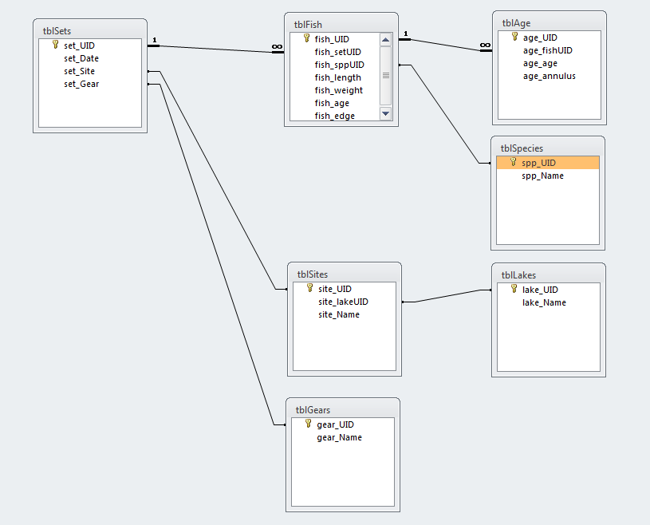

Slide 67
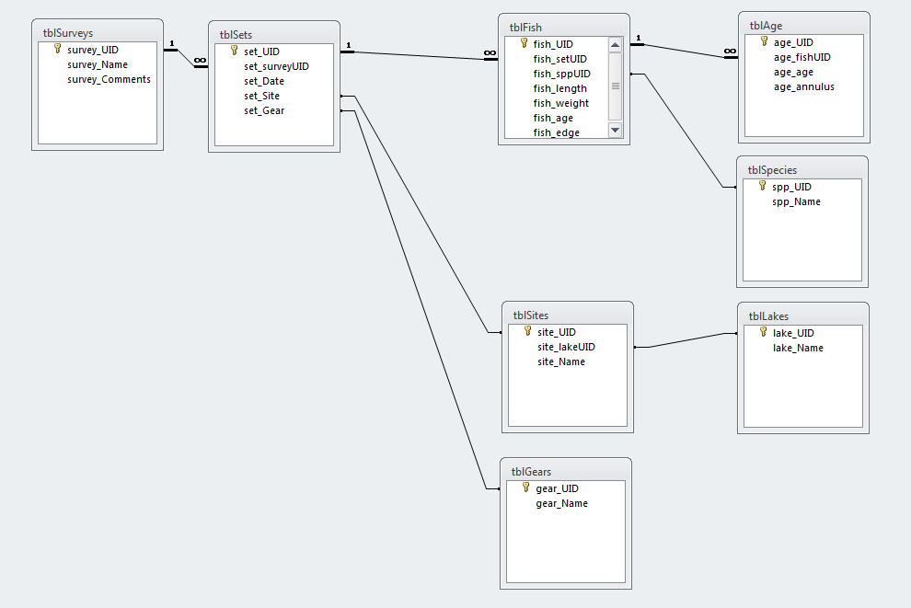

Slide 68
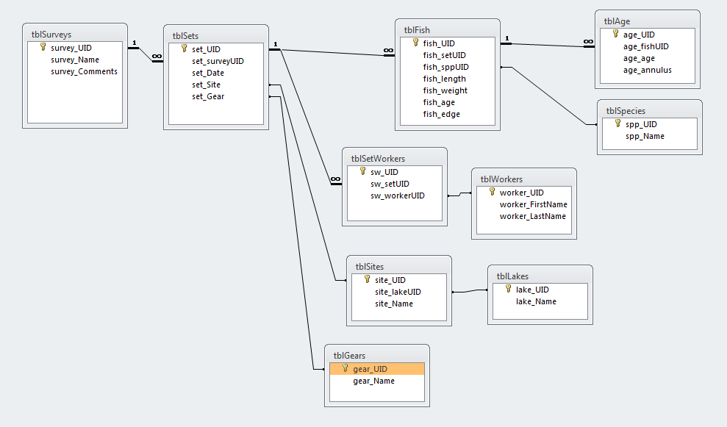

Slide 69
Data types
Text fields
text vs memo
text vs number
empty string vs null
Date/time fields
Boolean/bit fields
Integer/Double/Decimal
Specialty Fields
Nullable fields

Slide 70
Data type | Description | Storage
Text | Use for text or combinations of text and numbers. 255 characters maximum
Memo | Memo is used for larger amounts of text. Stores up to 65,536 characters. Note: You cannot sort a memo field. However, they are searchable
Byte | Allows whole numbers from 0 to 255 | 1 byte
Integer | Allows whole numbers between -32,768 and 32,767 | 2 bytes
Long | Allows whole numbers between -2,147,483,648 and 2,147,483,647 | 4 bytes
Single | Single precision floating-point. Will handle most decimals | 4 bytes
Double | Double precision floating-point. Will handle most decimals | 8 bytes
Currency | Use for currency. Holds up to 15 digits of whole dollars, plus 4 decimal places. Tip:You can choose which country's currency to use | 8 bytes
AutoNumber | AutoNumber fields automatically give each record its own number, usually starting at 1 | 4 bytes
Date/Time | Use for dates and times | 8 bytes
Yes/No | A logical field can be displayed as Yes/No, True/False, or On/Off. In code, use the constants True and False (equivalent to -1 and 0). Note: Null values are not allowed in Yes/No fields | 1 bit
Ole Object | Can store pictures, audio, video, or other BLOBs (Binary Large OBjects) | up to 1GB
Hyperlink | Contain links to other files, including web pages

Slide 71
Performance
Primary Keys
Indexes
Stored Procedures/Views

Slide 72
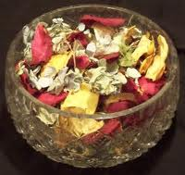
Database Potpourri
In operational systems, does history matter
In data systems, NEVER DELETE
Every record gets its own identifier
Use record counts as an early indicator
Avoid text variables….PERIOD
Naming conventions

Slide 73
???UID
???_???UID
???*******
???*******

Slide 74
???UID
tbl*******
???_???UID
frm*******
???*******
qry*******
???*******

Slide 75
Database Potpourri
In operational systems, does history matter
In data systems, NEVER DELETE
Every record gets its own identifier
Use record counts as an early indicator
Avoid text variables….PERIOD
Naming conventions
Define the difference between null and zero
Always beware of missing records

Slide 76
To Do
Create Lookup Tables To Remove Text
Split Out Sets Of Fields That Repeat Down Columns
Transpose columns to rows where possible
Goals
Each row represents one and only one piece of meaningful data
Each piece of data is in only one place
No data is in field headers
In production, can you add rows and not columns

Slide 77

Lets Make A Database!

Slide 78

Any Problems?

Slide 79
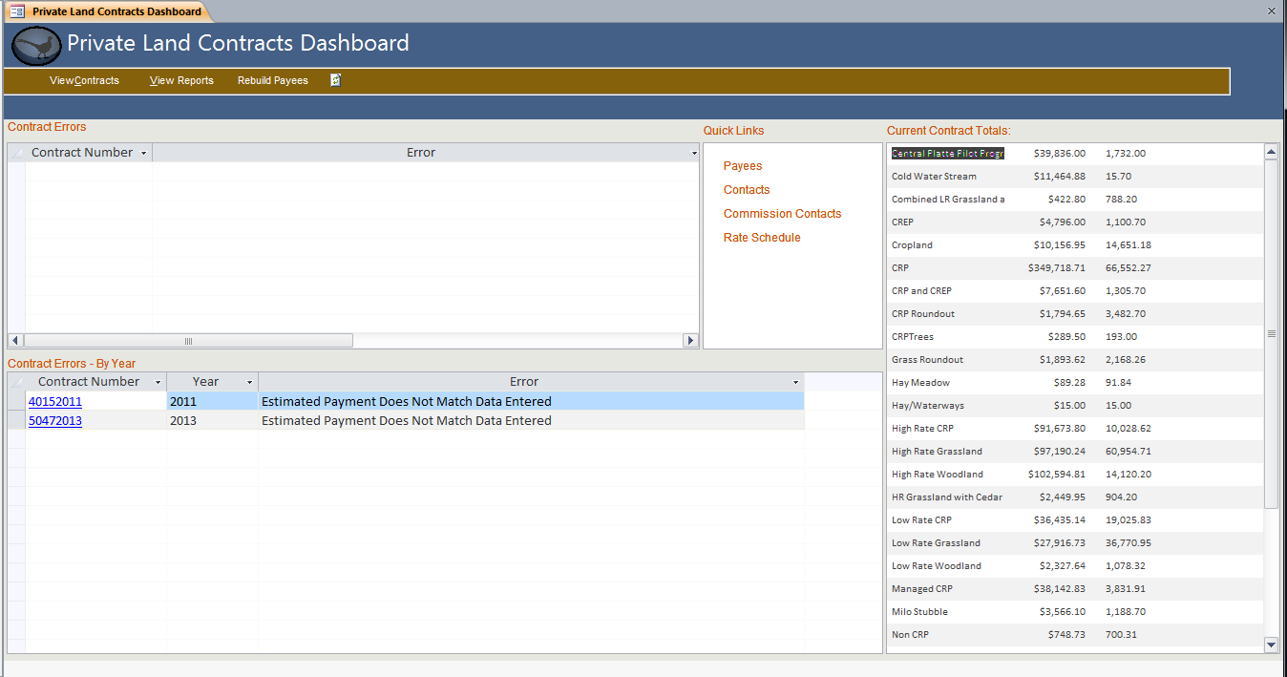

Slide 80
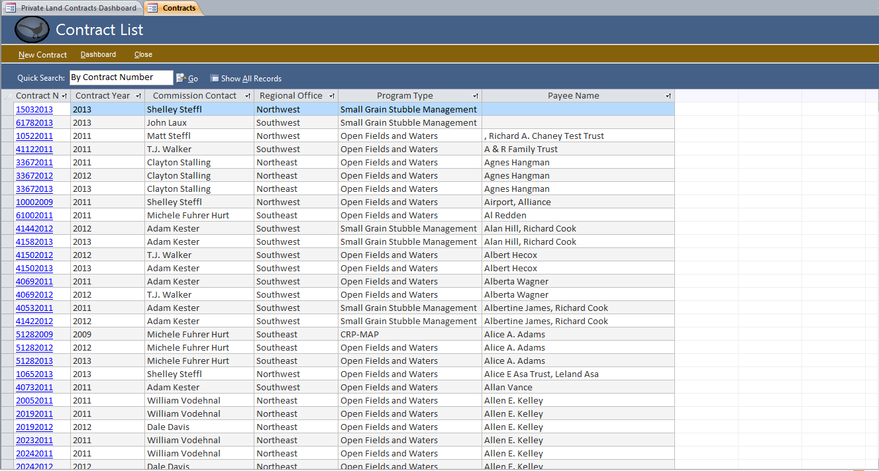

Slide 81
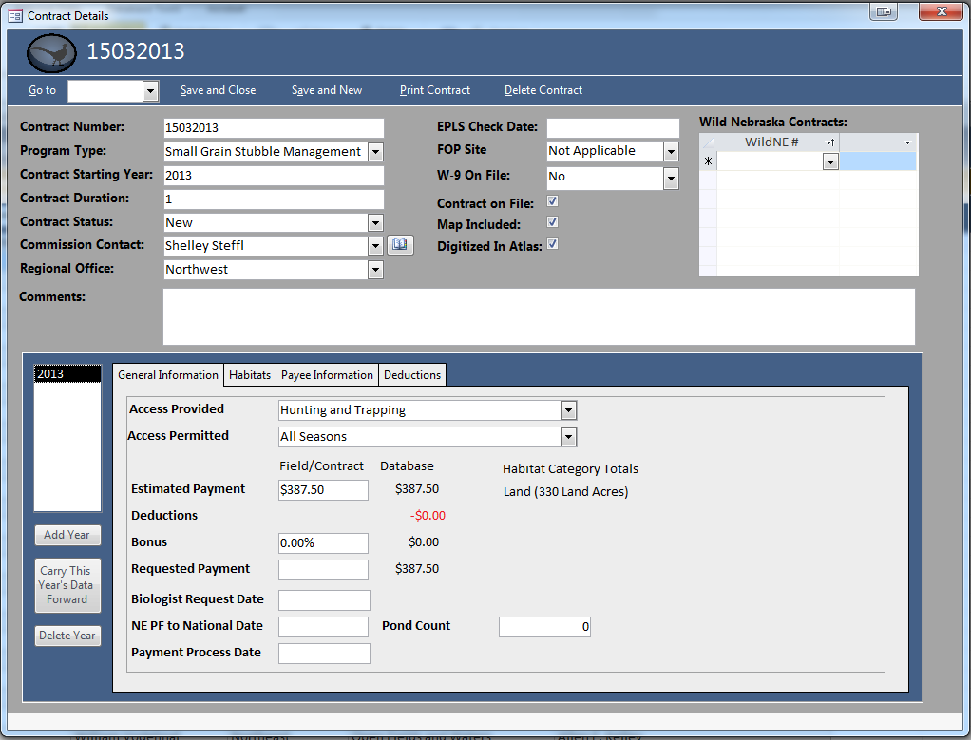

Slide 82
Queries and SQL
Notes:
Use access to show how to design a database
Good design means
simpler queries
better performance
less data entry
easier to add data fields without breaking backwards compatibility
Think of records as an “entity”…and then “sets” of entities”

Slide 83
CRUD Queries
Create
Update
Delete

Slide 84

Select A From B Where C
Select set_date From tblSets Where set_gear = 1

Slide 85
I’ve Learned So Much From My Mistakes…
I’m Thinking Of Making A Few More
Notes:
We’ve all made mistakes
Share one of mine.

